Slide 1



CLPS Incorporation
Nasdaq: CLPS

Slide 2
Chapter 6
Introduction of Spring MVC
CLPS Incorporation

Slide 3



Slide 4
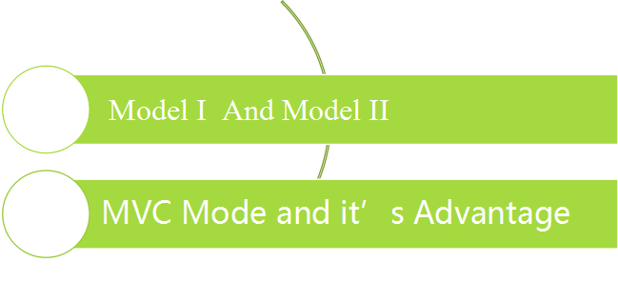
6.1 MVC Mode Outline
The structure of Java Web application has gone through two times: model I and model II. It is inevitable for technology to develop from model I to model II.
6.1.1
6.1.2

Slide 5
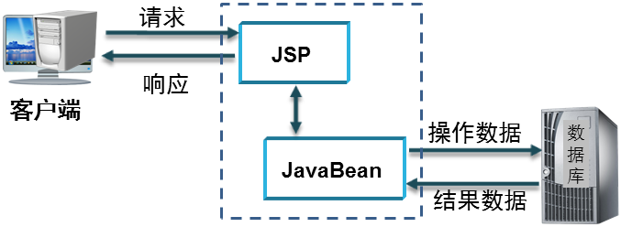
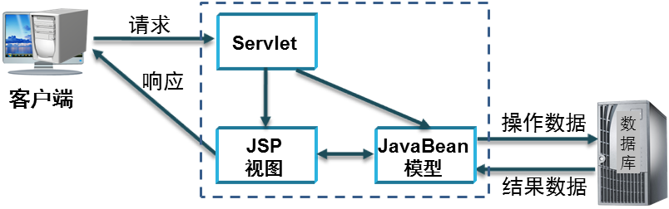
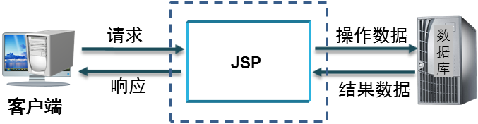
6.1.1 Model I 和 Model II
In the early Java Web application development, JSP file is responsible for dealing with the business logic and the running process of the control program, but also for the display of data, that is, using JSP file to independently complete all the tasks of the system functions. Traditional model I pattern, as shown in the figure.
The improved model I uses JSP pages and JavaBean components to cooperate to complete all tasks of system functions. JSP files are responsible for process control logic and data display logic tasks of programs, and JavaBean is responsible for processing business logic tasks. The improved model I pattern is shown.
Model II pattern is a design pattern based on MVC architecture. In model II mode, JSP page, servlet and JavaBean components are used to accomplish all the tasks of system functions. Among them, JSP is responsible for data display logic task, servlet is responsible for program flow control logic task, and JavaBean is responsible for business logic task. Model II mode, as shown in the figure.

Slide 6
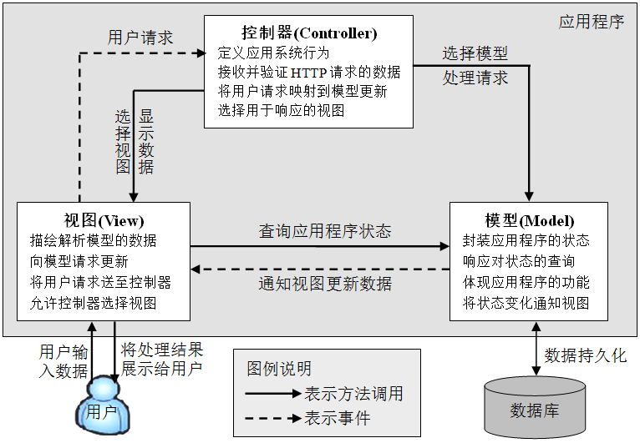
6.1.2 MVC Mode and it’s Advantage
MVC idea is not a unique design idea of which language, nor a unique idea of web application, it is a kind of specification. MVC idea divides an application into three basic parts: model, view and controller. These three parts work together with the least coupling, so as to improve the scalability and maintainability of the application. The relationship among model, view and controller in MVC design pattern is shown in the figure.

Slide 7
6.1.2 MVC Mode and it’s Advantage
In summary, MVC mode has the following characteristics:
Each performs its own duties and does not interfere with each other. In MVC mode, each layer performs its own functions. If the requirements of any layer change, only the code in the corresponding layer needs to be changed without affecting other layers.
Conducive to the division of labor in development. In MVC mode, because the system is separated by layers, the division of labor in development can be better realized. Web designers can develop JSP pages, developers who are familiar with business can develop methods of business processing in the model, while other developers can develop controllers for program control.
Facilitate the reuse of components. After layering, it is more conducive to the reuse of components. For example, the control layer can be independent into a general component, and the view layer can also be made into a general operation interface. The most important feature of MVC is to separate display and data, which increases the reusability of each module.

Slide 8
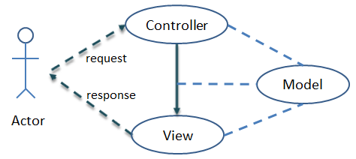
6.2 Spring MVC Outline
Spring MVC is a module for web application development in spring framework, which is a lightweight web framework based on MVC design pattern provided by spring. The spring framework provides a full-featured MVC module for building web applications. Spring MVC framework is essentially equivalent to servlet. It provides a dispatcher servlet as the front-end controller to dispatch requests. It also provides flexible configuration handler mapping, view parsing, language environment and topic parsing, and supports file upload.
In MVC design pattern, spring MVC, as controller, establishes data interaction between model and view. It is a typical MVC framework and the clearest MVC Model II implementation, as shown in the figure.

Slide 9
6.2 Spring MVC Outline
Spring MVC separates the roles of controllers, model objects, dispatchers, and handler objects, which makes them easier to customize. Spring MVC framework has surpassed struts 2 and other MVC frameworks in terms of framework design, extensibility and flexibility, and it is a part of spring framework itself. The integration with spring framework can be said to be seamless, with inherent advantages in performance. Spring MVC has the following characteristics ：
  Spring MVC is flexible, non intrusive and configurable
  Spring MVC provides a front-end controller dispatcher servlet, so developers do not need to develop additional controller objects.
  Spring MVC has a clear division of labor, including controller, validator, command object, model object, handler mapper and view parser, and each function implementation is in the charge of a special object.

Slide 10
6.2 Spring MVC Outline
  Spring MVC can automatically bind user input and convert data types correctly.
  Spring MVC uses a name / value map object for more flexible model data types.
  Spring MVC has built-in common validators to verify user input. If the validations are different, they will be redirected back to the input form. Input verification is optional, and supports the programming mode, i.e. declaration mode.
  Spring MVC supports internationalization, supports explicit multi-national languages according to user regions, and the internationalization configuration is very simple.
  Spring MVC supports a variety of view technologies, the most common of which are JSP technology and other technologies, including velocity and FreeMarker.
  Spring MVC provides a simple and powerful JSP tag library, which supports data binding function, making it easier to write JSP pages.

Slide 11
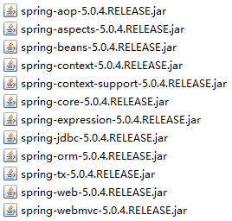
6.3 Spring MVC Environment Building
Next, build a spring MVC development environment and a simple spring MVC program to help readers understand the development steps of spring MVC program:
(1) Create a web project and add the required jar package.
In eclipse, create a web project named "spring mvc-1". In the previous chapter, you have downloaded the spring-framework-5.0.4.release-dist.zip file. In the extracted LIBS folder, see the figure below The 12 jar packages shown in 6-6, aopalliance-1.0.jar, aspectjweaver-1.9.1.jar, commons-logging-1.2.jar and cglib-3.2.0.jar are added to the webcontent \ WEB-INF \ lib directory of springmvc-1.
The jar files of spring MVC framework involved in the resource package are spring-web-5.0.4.release.jar and spring-webmvc-5.0.4.release.jar. 

Slide 12
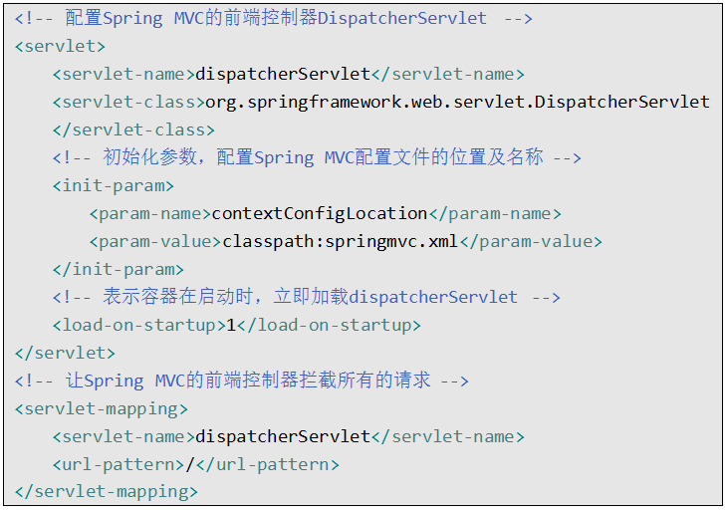
6.3 Spring MVC Environment Building
(2) In the web.xml file, configure the front-end controller dispatcher servlet of spring MVC
Spring MVC is a servlet based framework, and dispatcherservlet is the core of the whole spring MVC framework. It is responsible for receiving the goods request and dispatching it to the corresponding processor for processing. The key configuration code is as follows:

Slide 13
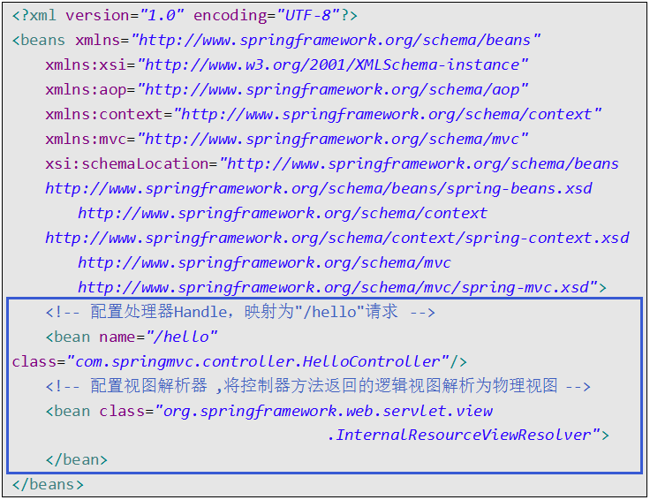
6.3 Spring MVC Environment Building
(3) 创建Spring MVC的配置文件
在项目springmvc-1的src目录下创建Spring MVC配置文件springmvc.xml，在该配置文件中，我们使用Spring MVC最简单的配置方式进行配置，主要配置处理器映射器和视图解析器。
在springmvc.xml文件中，首先要引入beans、aop、context和mvc命名空间；然后主要完成配置处理器映射和配置视图解析器。
① 配置处理器映射器
② 配置视图解析器

Slide 14
6.3 Spring MVC Environment Building
① Configure processor mapper
Spring provides a variety of handler mapping support, such as ：
  org.springframework.web.servlet.handler.BeanNameUrlHandlerMapping
  org.springframework.web.servlet.SimpleUrlHandlerMapping
  org.springframework.web.servlet.mvc.annotation.DefaultAnnotationHandlerMapping
  org.springframework.web.servlet.mvc.method.annotation.RequestMappingHandlerMapping
You can select processor mapping according to your needs. Here we choose beannameurlhandlermapping. If you do not explicitly declare any processor mapping, spring will use beannameurlhandlermapping by default, that is, to find the bean with the same name as the request URL in the spring container, declare the hellocontroller business controller class and map it to the / hello request.

Slide 15
6.3 Spring MVC Environment Building
② Configure view resolver
The last thing to process the request is to parse the output. This task is implemented by the view (JSP is used here). Then you need to determine: which view does the specified request need to use to parse the output of the request result? The dispatcher servlet finds a view resolver that converts the logical view name returned by the controller into the actual view of the result. Spring provides a variety of view parsers, such as ：
  org.springframework.web.servlet.view.InternalResourceViewResolver
  org.springframework.web.servlet.view.ContentNegotiatingViewResolver
In the springmvc.xml configuration file, there is no processor mapping and processor adapter configured. When the user does not configure these two items, spring will use the default processor mapping and processor adapter to process the request.

Slide 16
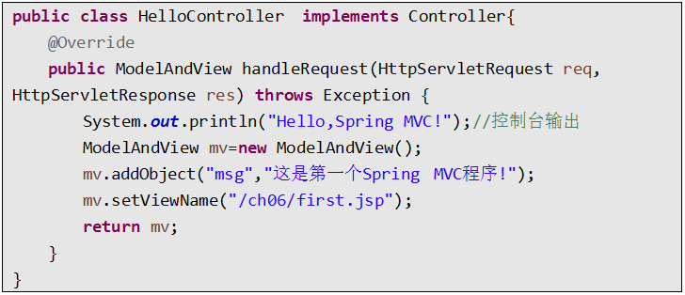
6.3 Spring MVC Environment Building
(4) Create a controller class to process requests
Create the package com.springmvc.controller in the SRC directory of the project, create the hellocontroller.java class in the package, and implement the handlerequest method in the controller interface to process the / Hello request. The code is as follows:

Slide 17

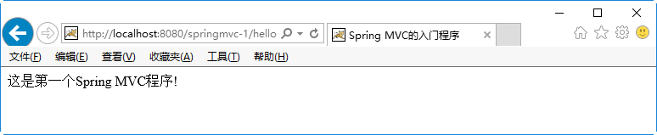
6.3 Spring MVC Environment Building
(5) Create view page
Create the CH06 folder under the webcontext path of the project, and create the JSP view page first.jsp in the CH06 folder. And output the information in "MSG" through the El expression on the view page, as shown on the right：
(6) Deploy project, start Tomcat test
Publish the project spring mvc-1 to tomcat, start the Tomcat server, visit http: / / localhost: 8080 / spring mvc-1 / Hello, and the operation effect is as shown in the figure.

Slide 18
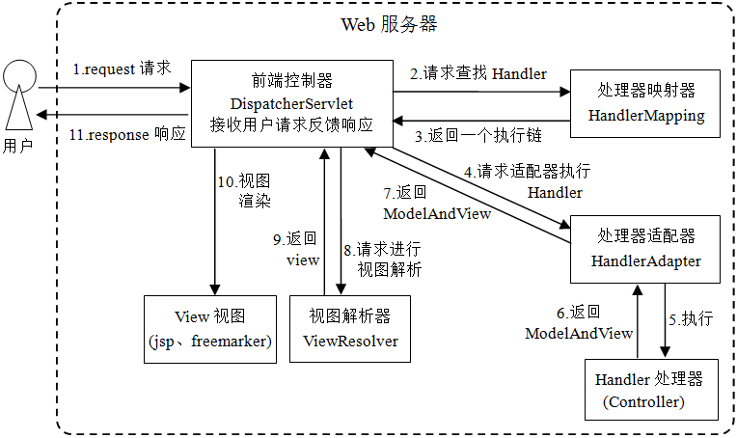
6.4 Spring MVC Request Flow
Through the previous examples, the processing flow of spring MVC is briefly summarized:
When the user sends the URL request http: / / localhost: 8080 / springmvc-1 / Hello, according to the configuration of dispatcherservlet in web.xml, the request is intercepted by the dispatcherservlet, and the controller (hellocontroller) for processing the corresponding request is found according to the handlermapping. After the controller processing is completed, the modelandview object is returned. The object tells the dispatcherservlet that it needs to communicate After which view to display the data model, the dispatcher servlet renders the logical view name returned by the controller into a real view and outputs it to the user according to the view parser.
Next, learn more about the request processing flow of spring MVC framework, as shown in the figure.

Slide 19
6.4 Spring MVC Request Flow
The user initiates a request from the client to the server, which is blocked by the front-end controller (dispatcher servlet).
The front-end controller requests the handler mapping to find the handler, which can be found according to the XML configuration or annotation.
The processor mapper finds the specific processor according to the request URL, generates the processor object and the processor interceptor (if any), and returns it to the front-end controller.
The front-end controller requests the handler adapter to execute the corresponding handler (often called the controller).
The processor adapter will call and execute the handler processor, which refers to the controller class written in the program, also known as the back-end controller. During the process of filling in the parameters of handler, spring will help to do some extra work according to the configuration.
After the controller is executed, it will return a modelandview object (spring MVC underlying object) to the processor adapter, which will contain view view information or model data model and view view view information.
After the processor adapter receives the modelandview returned by the controller, it returns it to the front-end controller.
After receiving the model and view, the front-end controller selects an appropriate view resolver to parse the view.
After the view parser parses, it will match the corresponding view results according to the view information and feed back to the front-end controller.
After receiving the view specific view, the front-end controller renders the view and fills the model data (in the modelandview object) into the request domain.
The front controller responds to the user.

Slide 20
6.3 Review
This chapter first introduces the MVC pattern, and then introduces the spring MVC framework. Through the introduction case to build the spring MVC environment, the workflow of spring MVC is explained in detail.

Slide 21

Thank You

